Slide 1
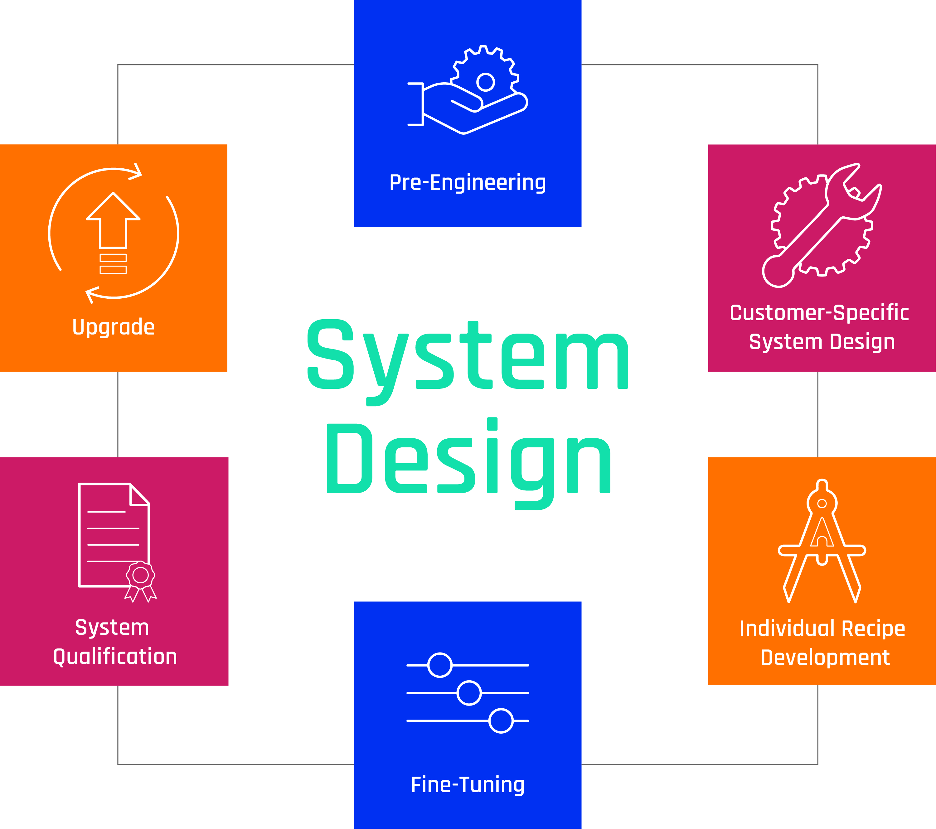
Custom-designed particle inspection for AVI Systems
Our approach to automated visual inspection goes beyond traditional visual inspection solutions. Based on our holistic system design, both software and hardware are individually tailored to customer requirements to achieve the highest possible production reliability.
The challenge
Parenteral drug products are required to be 100% visually inspected. As each product and its packaging define their specific inspection task, standardized inspection setups may lead to underperforming inspection results. In contrast, a customized solution provides the opportunity to improve the inspection by reducing false rejects and increasing the detection rates.
Our approach
For the visual inspection of parenteralia in various packaging materials, we rely on an individual system design in six phases. The customer-specific setup is developed in an intensive preparation phase and then incorporated into the machine design. This enables us to achieve the greatest possible reliability of the inspection results.

Slide 2
Pre-engineering as the key to success
A well-founded analysis of the customer needs creates the basis for an individual solution. For this purpose, a manual inspection is carried out in our own laboratory based on customers test criteria and the corresponding test sets, consisting of good and bad samples. The measurement results are then verified and documented. They form a common understanding of the defined inspection tasks. The holistic analysis also includes further test method procedures. A combination of various inspection technologies can significantly increase process reliability.
Customer-specific system design
Based on the knowledge gained from pre-engineering, the required hardware components are defined and a customer-specific optical design is created. We exclusively use state-of-the-art components. This is followed by the recording of image sequences in the laboratory, which are collected in a corresponding database. This database is used to evaluate the most powerful algorithms for inspection at each individual test station. A high degree of individualization is possible for both the software and the hardware. You have a large selection of algorithms, cameras and lighting at your disposal which can be individually combined for your project.
Individual recipe development
In a further process step, the image data is evaluated in detail. The individual parameters are optimized with the aid of a large number of preconfigured tools, thus increasing the inspection accuracy and performance (false reject rate and detection rate). For this purpose, specifically developed deep learning algorithms are used, for example to improve the differentiation between air bubbles and particles. The result is a customer-specific recipe.
In this phase, the optical components such as camera position, light setting, hardware, etc. are also defined. The optical path always remains the same. In this way, there are no moving parts such as mirrors or cameras, which reduces the susceptibility to errors to a minimum and increases the service life of the components. In addition, the optical path is developed in such a way that the entire format range is always covered. This eliminates the need for further adjustments to the optical design, eliminating another potential source of error.
Fine tuning
Based on the test results and customer requirements, we now define the automated visual inspection solution. The recommendations of the optical design and the software algorithms are documented. With the help of the integrated offline mode, a fine tuning of various form parameters is carried out and new form parameters are generated. Due to the flexible alignment and modular design, a transfer from the laboratory to the production system is easily possible.
Qualification of the system
Our vision team will support you during the qualification of your system. Function and qualification tests are carried out and support for the Knapp test is also part of our range of services. A comprehensive training for your team concludes the qualification.
Longterm sustainable use assured
Due to existing inspection functions and the modular system design, upgrading to new formats is extremely easy. Our vision team can help you implement new inspection functions or expand to new formats and products.
WILCO AG
Rigackerstrasse 11 T: +41 56 618 43 43 Made in Switzerland
5610 Wohlen info@wilco.com
Switzerland www.wilco.com Bausch+Ströbel group

